Slide 1

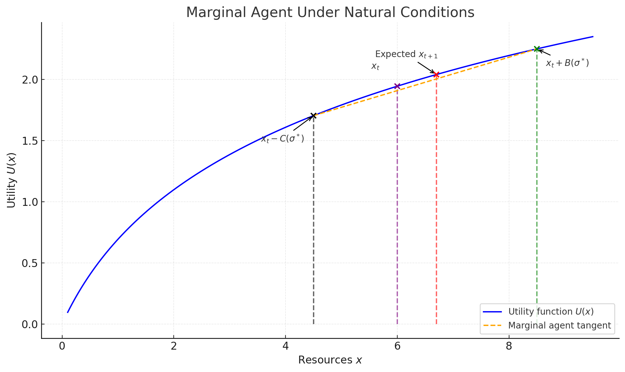
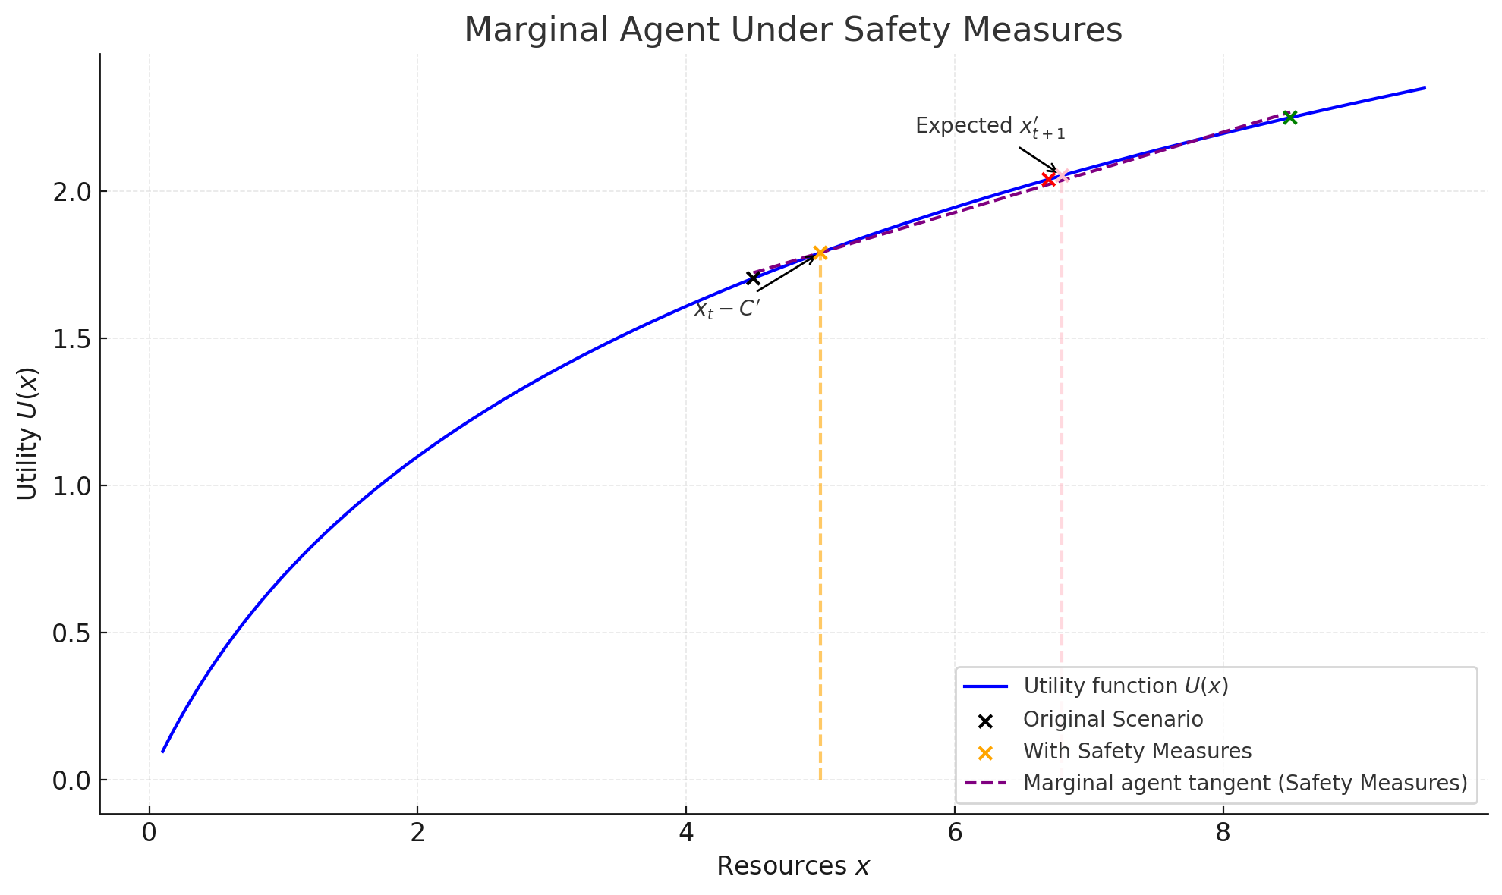





펠츠만 효과에 대한 행위자 중심 접근
Agent-Centered Approach on Peltzman Effect
서울대학교 경제학부 오지혜 ojhstar0103@snu.ac.kr
서울대학교 진화인류학 연구실
INTRODUCTION
GRAPHS
The Peltzman effect describes a counterintuitive behavioral phenomenon where individuals adjust their risk-taking actions in response to perceived changes in safety. This often leads to the unintended consequence of offsetting the benefits of safety measures.
In most existing studies, the Peltzman effect is examined through macro-level frameworks, focusing on aggregated societal impacts rather than individual-level decision-making processes. Such approaches often fail to capture the actor-centered dynamics—the nuanced choices made by individuals balancing risks and rewards under specific circumstances.
Thus, this research takes a novel agent-centered approach, focusing on the micro-level mechanisms underlying the Peltzman effect. Such an approach is critical for understanding the diverse range of risk responses among individuals, which are shaped by personal traits, resource availability, and ecological contexts.
(1) Marginal Agent Under Natural Conditions
(2) Marginal Agent Under Safety Measures
ASSUMPTIONS
(1) Agents choose the level of risk they take.
(2) Rewards and probabilities are determined by risk.
(3) Even without risks, entities gain baseline benefits.
(4) Marginal utility of resource acquisition diminishes.
(5) Time is treated discretely(static analysis).
VARIABLE SETTINGS
CONCLUSIONS
xt​ : Resources at time 𝑡​, xt​ ≥ 0
σ : Level of risk, σ ≥ 0
P(σ) : Probability of success, 0 < P < 1
B(σ) : Benefits of success, B(σ) ≥ 0
C(σ) : Costs of failure, C(σ) ≥ 0
U(x) : Utility of resources, U’(x) ≥ 0 and U’’(x) ≤ 0 for all x
x0 : Resources spent to survive during transition from
time t to t+1
The frameworks offers insight into how individuals adapt their risk-taking behavior when environmental conditions, such as perceived safety, change.
To improve the framework, future studies could revise assumptions plus incorporate dynamic modeling that accounts for long-term decision-making and repeated behaviors. Introducing behavioral complexity, such as cognitive, would make the model more reflective of real-world decision-making.
The ultimate goal of this research is to evolutionarily uncover not only the underlying mechanisms but also the ultimate causes of risk responses, which represent a highly plastic trait.
FUNCTION DESIGN
(1) Since U’(x) ≥ 0 for all x, comparing x is enough.
(2) Change in Resources
- When taking risk:
- When avoiding risk:
(3) Decision Criterion
- The entity compares and :
Choose risk-taking if
- σ* is chosen to maximize :
(4) Application to the Peltzman Effect:
- Policies reduce C by introducing a lower bound C’
- Let be the g(xt)​ distribution of resource levels
across the population, number of paradoxical
individuals N and Social Cost are:
REFERENCES
Kahneman, D., & Deaton, A. (2010). High income improves evaluation of life but not emotional well-being. Proceedings of the national academy of sciences, 107(38), 16489-16493.
Peltzman, S. (1975). The effects of automobile safety regulation. Journal of political Economy, 83(4), 677-725.
Peltzman, S. (1976). Toward a more general theory of regulation. The Journal of Law and Economics, 19(2), 211-240.

